Slide 1
UE18CS390B – Capstone Project Phase – 2
Project Progress Review #1
Project Title : Voice assisted form filling for differently abled people
Project ID : PW22MHR04
Project Guide : Dr. Mamatha HR
Project Team : 60_132_288_1529

Slide 2
Outline
Abstract and Scope of the Project
Capstone Project Phase – 1
Summary of work
Inferences drawn from Literature Survey
Expected Deliverables
Gantt chart

Slide 3
Problem addressed
Cumbersome process for the differently
abled to fill out forms themselves
Our project
Easy-to-use voice-based medium for automated record entry in the UDID (Unique Disability ID) form
ABSTRACT
Objective
Give the differently abled a sense of
independence
Inspire them to be a part of growing digital India
Adopted Approach
Perform speech to text & text to speech translation; intent detection & validation (intents: form’s field names), to ensure
meaningful data is stored
Fill UDID form using the stored records

Slide 4
Scope
Language of choice to fill the form restricted to English
1
Restricted to the UDID (Unique Disability ID) form
2
For file inputs, manual input by the user would be required
3

Slide 5
Summary of work done in Capstone Phase-1
Extensive research on:
Existing papers related to how the visually impaired navigate through online forms
How they use the computer system in general
Additional hardware and software components required to make their navigational process easier
Functionalities needed to implement voice based form filling (text-to-speech, speech-to-text,
intent detection)
Decided on modules and resources for implementation:
Datasets: LJ Speech Dataset, ATIS
Modules: Google speech API, NLTK, Pytorch, Librosa, TQDM etc.

Slide 6
Paper 1: "A framework to integrate speech based interface for blind web users on the websites of public interest."
Inference :
The proposed methodology involves having a speech enabler to record the form elements in order of traversal in the form of a macro.
On getting triggered a response page is created with a unique ID to each form element.
What we have incorporated in our project:
Our framework enables all the page elements, other than the active nodes to be ‘locked’.
Such that the differently abled person will be able to move to answer the next question only if he/she has answered the previous question.
Traversal is in a definitive order.

Slide 7
Paper 2: “Noisy Speech Recognition using Wavelets and FCM”
Inference :
The proposed methodology involves feature extraction methods like PLP, RASTA, MFCC and hybrid algorithms.
Clustering methods like Vector quantization and Fuzzy C Means.
Methods shown on how to prevent overfitting of data
What we have incorporated in our project :
Building a sequential Neural Network intent detection and validation to make sure the model does not overfit the dataset that will be made.
Regularizing the model to prevent overfitting.

Slide 8
Paper 3: "Implementation of speech to text conversion.”
Inference :
The proposed methodology involves speech to txt conversion, while incorporating hardware elements based on raspberry pi.
they develop an on-line speech-to-text engine. The system acquires speech at run time through a microphone and processes the sampled speech to identify the uttered text.
Included insights of how to incorporate solenoid plates
What we have incorporated in our project:
For the purpose of achieving high accuracy and conversion speed , the Google speech-to-text API will be used.

Slide 9
Paper 4: "Query Understanding via Intent Description Generation."
Inference :
This paper incorporate Query understanding using techniques like , Query Classification and Query Clustering.
A novel CtrsGen model was made to deal with the task of Query-to-Intent-Description.
What we have incorporated in our project :
The function for creating a question intent has two parts.
Clean and format: Cleaning and formatting questions (removing special char and extra lines and converting num to text)
Create Intent: based on tags (reqd, optional, radio, checkbox etc) understand what type of response is expected, manually assigning intents for each question & creating a json file with the intent and question

Slide 10
Paper 5: “Voice based Email System Application for Blind"
The paper is broken down into the proposed system and the methods of implementation:
Speech to Text (STT): Here, the audio input (either an audio file or streaming of someone speaking) will get converted to txt format and will be saved in .txt file.
Text to Speech (TTS): Here, the text format of the emails is converted to synthesized speech.
Interactive voice response (IVR): Using this, a user can interact with an email host system using a system keyboard. By listening to the IVR dialogue, users can service their own queries. The IVR system will usually respond with a pre-recorded audio voice to further inform the user how to proceed.

Slide 11

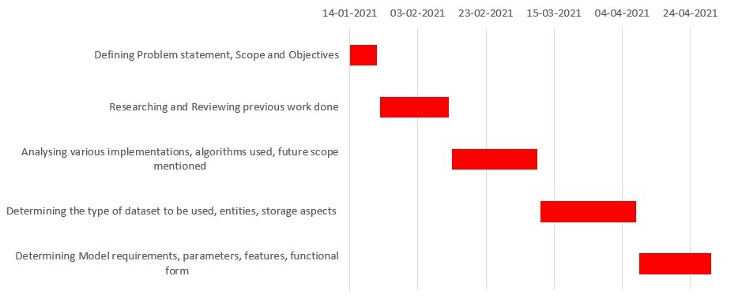
Gantt Chart for Phase 1

Slide 12

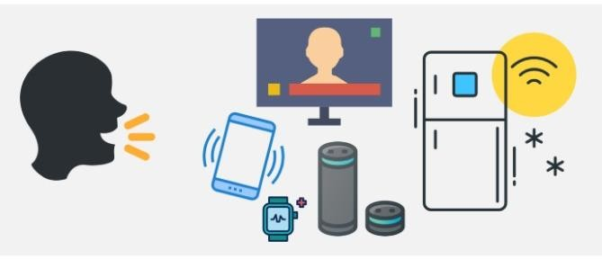
Suggestions
By the end of Phase-2, completely make the “system-user” interaction voice-based, emulating a chatbot like scenario to open and access the form.

Slide 13
User Interface
User fills the form normally
No
Voice prompt: Fill using voice?
Kiosk continuously listens for user’s request to fill a form
Open our UI
Yes

Slide 14
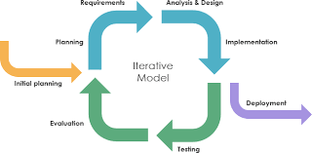
Software development life cycle – Iterative Model
The model we have selected is an iterative model as we had come up with an initial framework regarding the plan of implementation.
This was followed by starting off with a simple module and adding complexities as we progressed.
This type of model reduced the cost of error detection and correction, helped with risk mitigation and provided a more flexible framework to work with.

Slide 15
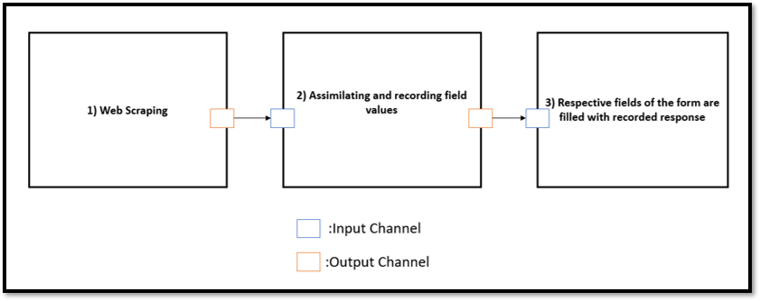
Expected Deliverables
High Level Design of our Implementation

Slide 16
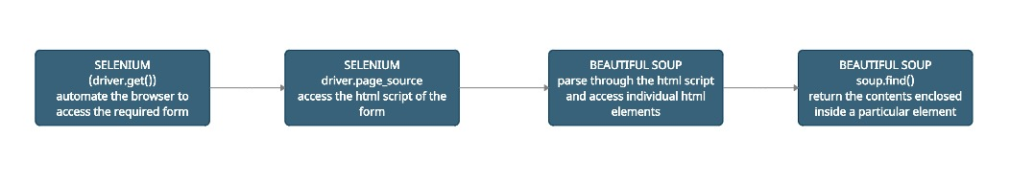
Implementation Plan
1) Creating a demo form: Used Django to create forms to currently test out the written programs
2) Modules used
a) Web scraping

Slide 17
We use the Web Scraping module to list down the questions and classify questions into the following tags:
Required
Optional
Radio
Choice
Checkbox
This is written into a text file questions.txt
Selenium: Powerful tool for controlling web browsers through programs and performing browser automation.
WebDriver: WebDriver is a browser automation framework that works with open source APIs. The framework operates by accepting commands, sending those commands to a browser, and interacting with applications.
BeautifulSoup: Python library, WE use it to parse HTML script and extract questions from the script

Slide 18
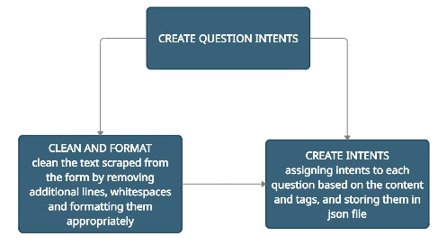
b) Create Question Intents

Slide 19
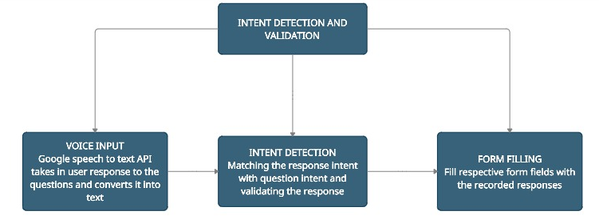
c) Intent detection and validation
PyTorch: Open-source library to build the intent detection model
NLTK: We use this Natural Language Toolkit for feature extraction of the text converted from the speech to give out the relevant intent
We'll be using selenium and it's methods like send_keys() to fill the respective form fields with the responses we've collected

Slide 20
Plan of Action
For now, the intent detection & validation has been coded specifically to work for our form
We used the ATIS dataset to train our model, however it didn’t suit our model well
We are in the process of building our own dataset for our ML model (sequential Neural Network), for the intent detection and validation process

Slide 21
Complexities encountered to implement UI for the differently abled
1) Making the entirety of the form voice based
2) The process of repeating answers/questions and confirming responses
3) Converting the accessing the form process voice based
4) A custom guide to explain a certain difficulty user may encounter while filling the form
5) In the end, once the final responses are read out to the User, implementing the functionality to facilitate changes to responses if needed
6) Creating our custom Dataset to train our ML model

Slide 22
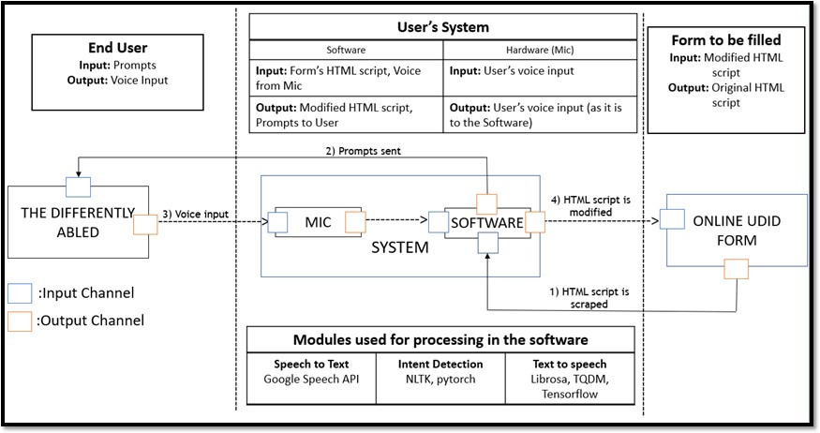
Architecture Diagram To Summarise our Processes and their Interdependencies

Slide 23
Distribution of Work
Student Name | Student SRN | Tasks assigned | Time spent
Sunit Koodli | PE120180060 | Web scraping, database creation(ongoing) | 15 days
Shreya Sri | PE120180132 | Demo form creation and creating intents, model building(ongoing) | 20 days
Pranav S Nair | PE120180288 | Intent detection and validation, model building(ongoing) | 22 days
Mahah Sadique | PE1201801529 | Creating intents, database creation(ongoing) | 15 days

Slide 24
Module 1: Speech To Text
Google Speech API
Module 2: Intent detection
NLTK, Pytorch
TECHNOLOGIES USED
Module 3: Text to speech
Librosa, TQDM, Tensorflow
Code/implementation
Python 3

Slide 25

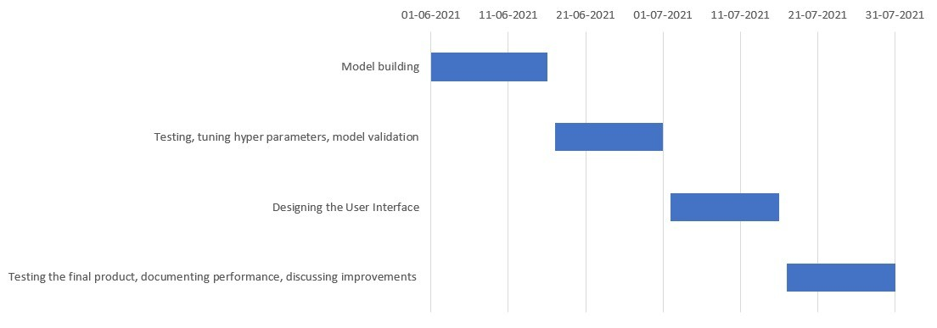
Gantt Chart for Capstone Phase-2

Slide 26
References
Verma, Prabhat, Raghuraj Singh, and Avinash Kumar Singh. "A framework to integrate speech based interface for blind web users on the websites of public interest." Human-Centric Computing and Information Sciences 3.1 (2013): 1-18.
https://hcis-journal.springeropen.com/track/pdf/10.1186/2192-1962-3-21.pdf
H. Y. Vani and M. A. Anusuya. 2016. Noisy Speech Recognition using Wavelets and FCM. In Proceedings of the 4th International Conference on Information and Network Security (ICINS '16). Association for Computing Machinery, New York, NY, USA, 83–88.
https://doi.org/10.1145/3026724.3026737
Khilari, Prachi, and V. P. Bhope. "Implementation of speech to text conversion.“ International Journal of Innovative Research in Science, Engineering and Technology 4.7 (2015): 6441-6450. http://www.ijirset.com/upload/2015/july/167_IMPLEMENTATION.pdf

Slide 27
[4] Zhang, Ruqing, et al. "Query Understanding via Intent Description Generation." Proceedings of the 29th ACM International Conference on Information & Knowledge Management. 2020. https://arxiv.org/abs/2008.10889
Shirin Feiz, Syed Masum Billah, Vikas Ashok, Roy Shilkrot, and IV Ramakrishnan. 2019. Towards Enabling Blind People to Independently Write on Printed Forms. In <i>Proceedings of the 2019 CHI Conference on Human Factors in Computing Systems</i> (<i>CHI '19</i>). Association for Computing Machinery, New York, NY, USA, Paper 300, 1–12. DOI:https://doi.org/10.1145/3290605.3300530 https://dl.acm.org/doi/10.1145/3290605.3300530
Ingle, Pranjal, Harshada Kanade, and Arti Lanke. "Voice based e-mail System for Blinds." International Journal of Research Studies in Computer Science and Engineering (IJRSCSE) 3.1 (2016): 25-30.
https://www.arcjournals.org/pdfs/ijrscse/v3-i1/5.pdf

Slide 28
Thank You

